Slide 1


Slide 2
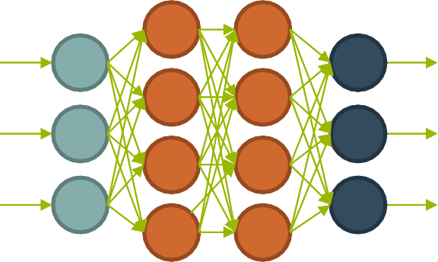
Motivation for Neural Nets
Use biology as inspiration for
mathematical model
Get signals from previous neurons
Generate signals (or not) according to inputs
Pass signals on to next neurons
By layering many neurons, can create complex model

Slide 3
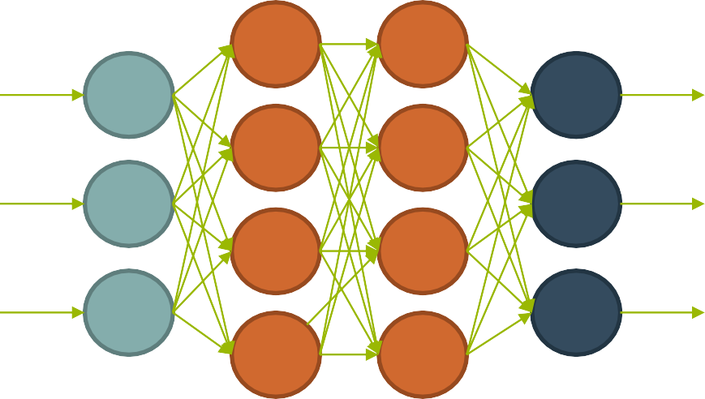
Neural Net Structure
Input
(Feature Vector)
Output
(Label)
Can think of it as a complicated computation engine
We will ”train it” using our training data
Then (hopefully) it will give good answers on new data

Slide 4
Basic Neuron Visualization
activation function

Slide 5



Basic Neuron Visualization
Data from
previous layer
activation function

Slide 6

Basic Neuron Visualization
Some form of computation transforms the inputs
activation function

Slide 7

Basic Neuron Visualization
activation function
The neuron outputs the transformed data

Slide 8
Basic Neuron Visualization
x₁
activation function
x w
2
2
x₃

Slide 9
Basic Neuron Visualization
x₁
activation function
x w
2
2
x₃
1

Slide 10
Basic Neuron Visualization
x₁
z = x₁w₁+ x₂w₂+ x₃w₃+b
activation function
x w
f(z)
2
2
x₃
1

Slide 11
In Vector Notation
𝑚
𝑧 = 𝑏 + sum(𝑥_{𝑖}𝑤_{𝑖 )}
𝑖=1
𝑧 = 𝑏 + 𝑥^{𝑇}𝑤
𝑎 = 𝑓(𝑧)
z = “net input” b = “bias term”
f = activation function
a = output to next layer

Slide 12
Relation to Logistic Regression
When we choose: 𝑓 𝑧 =
1
1+𝑒^{−𝑧}
𝑚
𝑧 = 𝑏 + sum(𝑥_{𝑖} 𝑤_{𝑖 )} = 𝑥₁𝑤₁ + 𝑥₂𝑤₂ + ⋯ + 𝑥_{𝑚}𝑤_{𝑚} + 𝑏
𝑖=1
Then a neuron is simply a ”unit” of logistic regression!
weights ⬄ coefficients inputs ⬄variables
bias term ⬄ constant term

Slide 13
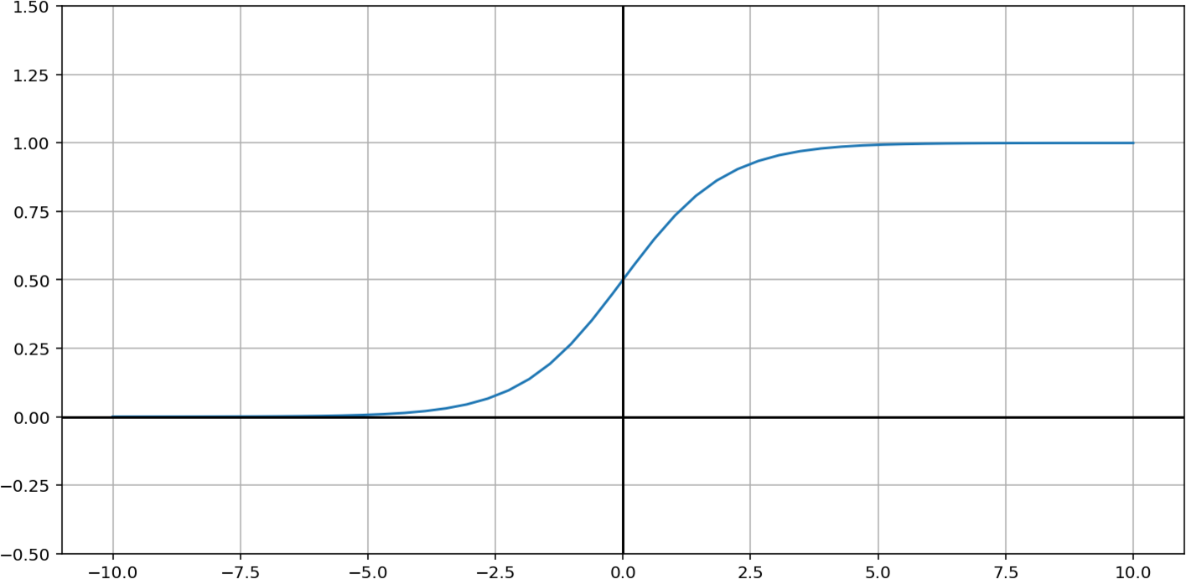
Relation to Logistic Regression
1
⁼ 1 + 𝑒^{−𝑧}
This is called the “sigmoid” function:
𝜎 𝑧

Slide 14



Nice Property of Sigmoid Function
1
𝜎 𝑧 =
1 + 𝑒^{−𝑧}
Quotient rule
𝑑 𝑓(𝑥) 𝑓′ 𝑥 𝑔 𝑥 − 𝑓 𝑥 𝑔′(𝑥)
−𝑧
−𝑧
⋅ =
0 − (−𝑒 )
𝑒
𝑑𝑥 𝑔(𝑥) 𝑔 𝑥
2
𝜎′ 𝑧 =
=
1 + 𝑒^{−𝑧}
1 + 𝑒^{−𝑧}
1 + 𝑒^{−𝑧}
2
2
1 + 𝑒^{−𝑧} − 1
1
=
=
₂ −
1 + 𝑒^{−𝑧}
2
1 + 𝑒^{−𝑧}
1 + 𝑒^{−𝑧}
2
1
= −
1 + 𝑒^{−𝑧} 1 + 𝑒^{−𝑧}
1
1
1 −
1 + 𝑒^{−𝑧}
1
=
1 + 𝑒^{−𝑧}
2
𝜎′ 𝑧
= 𝜎(𝑧)(1 − 𝜎(𝑧))
This will be helpful!

Slide 15
Example Neuron Computation
x₁
z = x₁w₁+ x₂w₂+ x₃w₃+b
(sigmoid) activation function
x₂ w₂
f(z)
x₃
1

Slide 16
Example Neuron Computation
.9
z = x₁w₁+ x₂w₂+ x₃w₃+b
(sigmoid) activation function
.2
3
f(z)
.3
1

Slide 17
Example Neuron Computation
.9
z = .9(2)+ .2(3)+ .3(-1)+.5 = 2.6
(sigmoid) activation function
.2
3
f(z)
.3
1

Slide 18
Example Neuron Computation
.9
z = .9(2)+ .2(3)+ .3(-1)+.5 = 2.6
f(z)=f(2.6)=1/(1+exp(-2.6))
= .93
(sigmoid) activation function
.2
3
.3
1

Slide 19
Example Neuron Computation
.9
z = .9(2)+ .2(3)+ .3(-1)+.5 = 2.6
f(z)=f(2.6)=1/(1+exp(-2.6))
= .93
(sigmoid) activation function
.2
3
Neuron would output
the value .93
.3
1

Slide 20
Why Neural Nets?
Why not just use a single neuron?
Why do we need a larger network?
A single neuron (like logistic regression) only permits a linear decision boundary.
Most real-world problems are considerably more complicated!

Slide 21
Feedforward Neural Network
𝜎
𝜎
𝑥₁
𝑦 ₁
𝜎
𝜎
𝑥₂
𝑦 ₂
𝜎
𝜎
𝑥₃
𝑦 ₃
𝜎
𝜎

Slide 22
Weights
𝜎
𝜎
𝑥₁
𝑦 ₁
𝜎
𝜎
𝑥₂
𝑦 ₂
𝜎
𝜎
𝑥₃
𝑦 ₃
𝜎
𝜎

Slide 23
Input Layer
𝜎
𝜎
𝑥₁
𝑦 ₁
𝜎
𝜎
𝑥₂
𝑦 ₂
𝜎
𝜎
𝑥₃
𝑦 ₃
𝜎
𝜎

Slide 24
Hidden Layers
𝜎
𝜎
𝑥₁
𝑦 ₁
𝜎
𝜎
𝑥₂
𝑦 ₂
𝜎
𝜎
𝑥₃
𝑦 ₃
𝜎
𝜎

Slide 25
Output Layer
𝜎
𝜎
𝑥₁
𝑦 ₁
𝜎
𝜎
𝑥₂
𝑦 ₂
𝜎
𝜎
𝑥₃
𝑦 ₃
𝜎
𝜎

Slide 26
Weights (represented by matrices)
_{𝑊}(1)
𝜎
𝑥₁
𝜎
𝑥₂
𝜎
𝑥₃
𝜎
_{𝑊}(2)
_{𝑊}(3)
𝜎
𝑦 ₁
𝜎
𝑦 ₂
𝜎
𝑦 ₃
𝜎

Slide 27
Net Input (sum of weighted inputs, before activation function)
_{𝑧}(2) _{𝑧}(3) _{𝑧}(4)
𝜎 𝜎
𝑥₁
𝑦 ₁
𝜎
𝜎
𝑥₂
𝑦 ₂
𝜎
𝜎
𝑥₃
𝑦 ₃
𝜎
𝜎

Slide 28
Activations (output of neurons to next layer)
_{𝑎}(2)
_{𝑎}(3)
_{𝑎}(1)
𝜎 𝜎
_{𝑎}(4)
𝑥₁
𝑦 ₁
𝜎
𝜎
𝑥₂
𝑦 ₂
𝜎
𝜎
𝑥₃
𝑦 ₃
𝜎
𝜎

Slide 29
Matrix representation of computation
_{𝑧}(2)
_{𝑎}(2)
_{𝑊}(1)
𝜎
𝑥₁
𝑥
𝑊⁽¹⁾ is a 3x4 matrix
𝜎
(𝑥 = 𝑎⁽¹⁾)
_{𝑧}(2) _{= 𝑥𝑊}(1)
𝑎⁽²⁾ = 𝜎(𝑧 ² )
(2)
𝑥
𝑧 is a
2
4-vector
𝜎
𝑎⁽²⁾ is a 4-vector
𝑥
3
𝜎

Slide 30
Continuing the Computation
For a single training instance (data point)
Input : vector x (a row vector of length 3)
Output : vector 𝑦 (a row vector of length 3)
_{𝑧}(2) _{= 𝑥𝑊}(1)
_{𝑧}(3) _{= 𝑎}(2)_{𝑊}(2)
_{𝑧}(4) _{= 𝑎}(3)_{𝑊}(3)
𝑎⁽²⁾ = 𝜎(𝑧 ² )
𝑎⁽³⁾ = 𝜎(𝑧 ³ )
𝑦 = 𝑠𝑜𝑓𝑡𝑚𝑎𝑥(𝑧 ⁴ )

Slide 31
Multiple data points
In practice, we do these computation for many data points at the same time,
by “stacking” the rows into a matrix. But the equations look the same!
Input : matrix x (an nx3 matrix) (each row a single instance)
Output : vector 𝑦 (an nx3 matrix) (each row a single prediction)
_{𝑧}(2) _{= 𝑥𝑊}(1)
_{𝑧}(3) _{= 𝑎}(2)_{𝑊}(2)
_{𝑧}(4) _{= 𝑎}(3)_{𝑊}(3)
𝑎⁽²⁾ = 𝜎(𝑧 ² )
𝑎⁽³⁾ = 𝜎(𝑧 ³ )
𝑦 = 𝑠𝑜𝑓𝑡𝑚𝑎𝑥(𝑧 ⁴ )

Slide 32
Now we know how feedforward NNs do Computations.
Next, we will learn how to adjust the weights to learn from data.

